Slide 1
Yemen’s economic lifeline:
Analyzing World Bank Loans through SQL

Slide 2
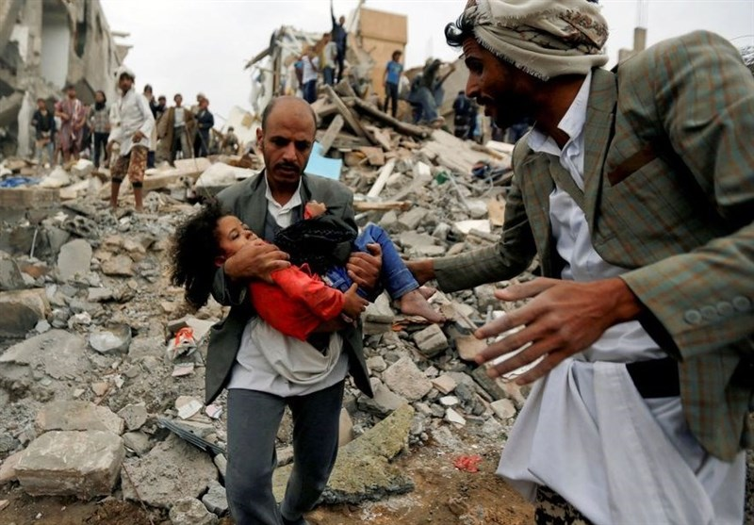
Choosing to focus on Yemen using data from the International Development Association (IDA) of the World Bank provides a unique opportunity to delve into one of the most pressing humanitarian crises of our time. Yemen's multifaceted challenges, including ongoing conflict, widespread poverty, food insecurity, and inadequate healthcare, underscore the urgency of understanding and addressing the country's needs. By analyzing IDA data, researchers can gain valuable insights into the allocation and utilization of financial resources aimed at mitigating these challenges. This analysis can illuminate patterns of aid distribution, identify areas of critical need, assess the effectiveness of interventions, and highlight gaps in assistance. Furthermore, exploring the nuances of aid flows to Yemen can shed light on broader issues of global development finance, international cooperation, and the complexities of providing assistance in conflict-affected settings. Through rigorous data analysis and thoughtful interpretation, this project has the potential to inform policymaking, support advocacy efforts, and ultimately contribute to improving the lives of millions of Yemenis who are grappling with the consequences of protracted crisis and deprivation.
This Photo by Unknown Author is licensed under CC BY

Slide 3
In analyzing Yemen's World Bank IDA data, several trends emerge regarding the types of projects funded, borrowing entities, and credit statuses of loans. Here's a breakdown:
Types of Projects Funded:
Infrastructure Development
Healthcare Initiatives
Education Programs
Agricultural Development
Borrowing State Department:
Minister of Planning & Intl Co-operation
H.E. Dr. Mohammed Saed Al-Sadi
Ministry of Agriculture & Fisheries
Tresorier Payeur General
Credit Status of the Loan:
Cancelled
Disbursed
Fully Cancelled
Fully Repaid
Repaid
Repaying

Slide 4
The IDA is a part of the World Bank Group that focuses on providing concessional loans and grants to the world's poorest countries. The data typically includes details about the projects funded, sectors targeted (e.g., education, healthcare, infrastructure, agriculture), loan amounts, terms of financing (service charge rates, first payment date), and the countries receiving assistance. Analyzing this data helps policymakers, researchers, and development practitioners understand the allocation of resources, assess the impact of projects, and track progress towards development goals in recipient countries like Yemen. I’ll be using the IDA data from November 2022. The data table is 30 columns by 1,109,994 rows and it can be found here: https://finances.worldbank.org/ . I’ll be using SQL to analyze this data and will be using functions to focus only on those loans that have cancelled. One thing to note here is that the loans are made in two different currencies: USD (U.S. Dollars) & XDR (Special Drawing Rights) which is a currency made up of currencies from five different countries and has an exchange rate of about .75 to $1 U.S. Some examples of the table columns that I will be using to analyze this data are: Region, Country, Borrower, Project Name, Cancelled Amount, Currency of Commitment, and Credit Status.

Slide 5
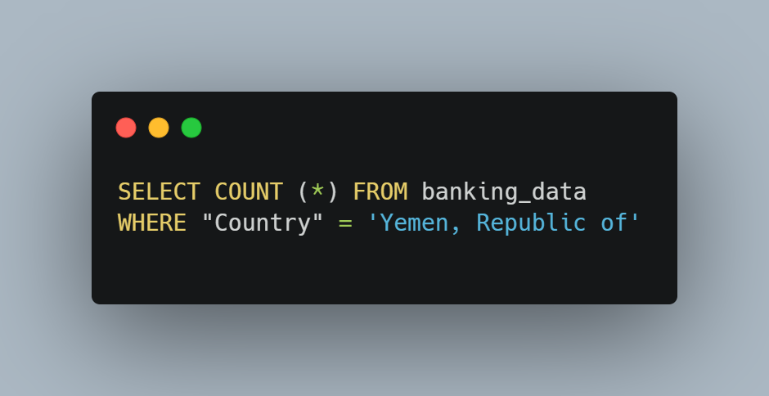
First, I wanted to filter down to just Yemen data. I did this by writing a SQL query to filter out all other countries. This yielded a total of 25,572 rows of data pertaining to just Yemen. Below is a sample of that query.

Slide 6
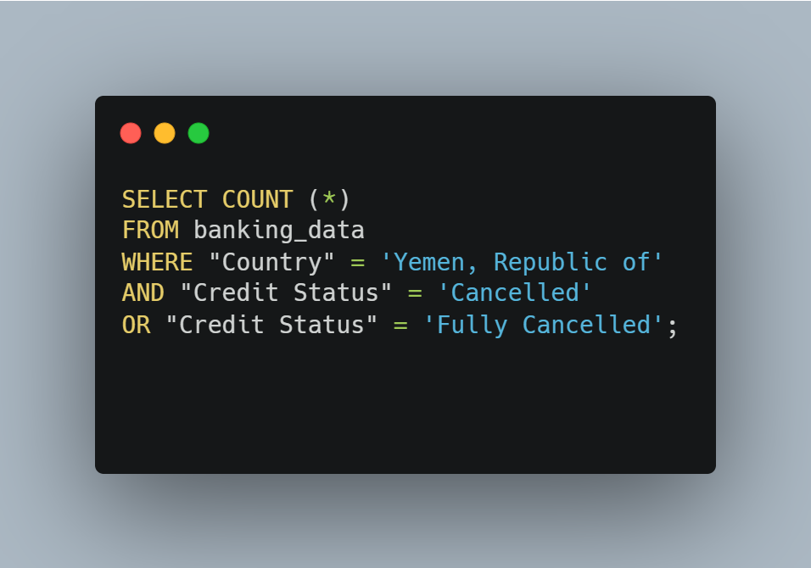
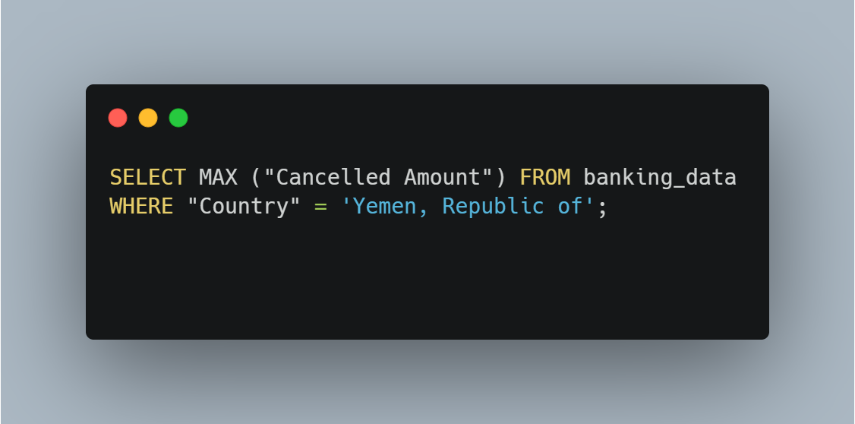
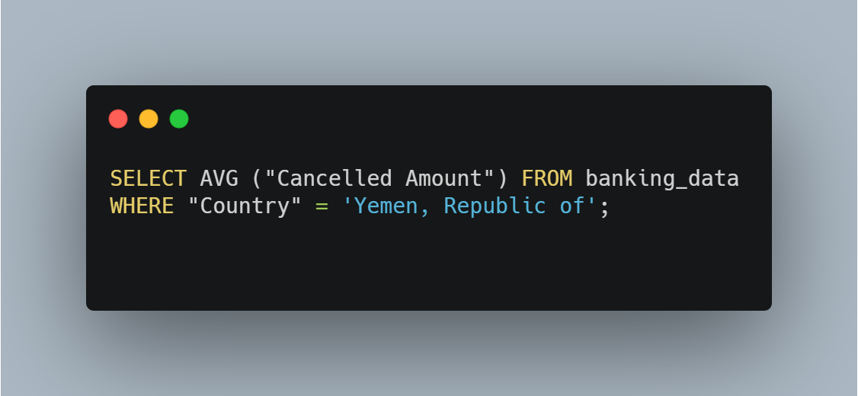
Of particular interest is the number of loans that have been cancelled (9,237), the MAX amount cancelled (133,540,000 XDR) and the Average amount cancelled (3,245,781.35 XDR). This is important because the IDA can financially help poorer countries like Yemen with loan credits that save these countries from crippling debt and allow them the opportunity to rebuild.

Slide 7
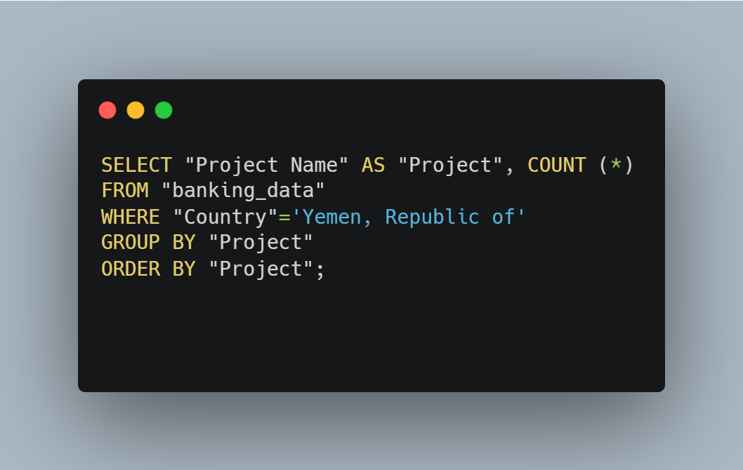
I was able to use a SQL query to find out the types of projects that the IDA has funded in Yemen. To my astonishment there are 196 different categories of projects that have been funded. These cover vital programs to enrich education, healthcare, infrastructure (roads, highway and water access) and agriculture. The amount of loans ranged from 1 for YUISEP II (improves critical urban services) to 417 loans to help with groundwater and soil conservation.

Slide 8
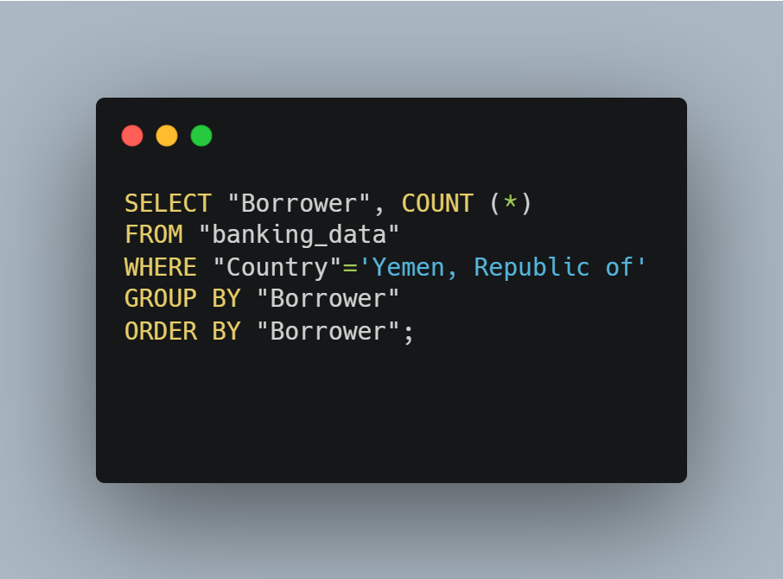
Lastly, I wanted to use SQL to discover which State Departments within the Republic of Yemen were borrowing the money for these projects. I was able to determine that 20 different departments or individuals borrowed the money for Yemeni projects. The largest borrower was the Minister of Planning & Intl Co-operation with 19,704 loans and the smallest borrower was the World Food Programme with only 41 loans. This would be an area that I would want to dive into deeper to see if the money is being properly used and what projects each of these department’s fund.

Slide 9
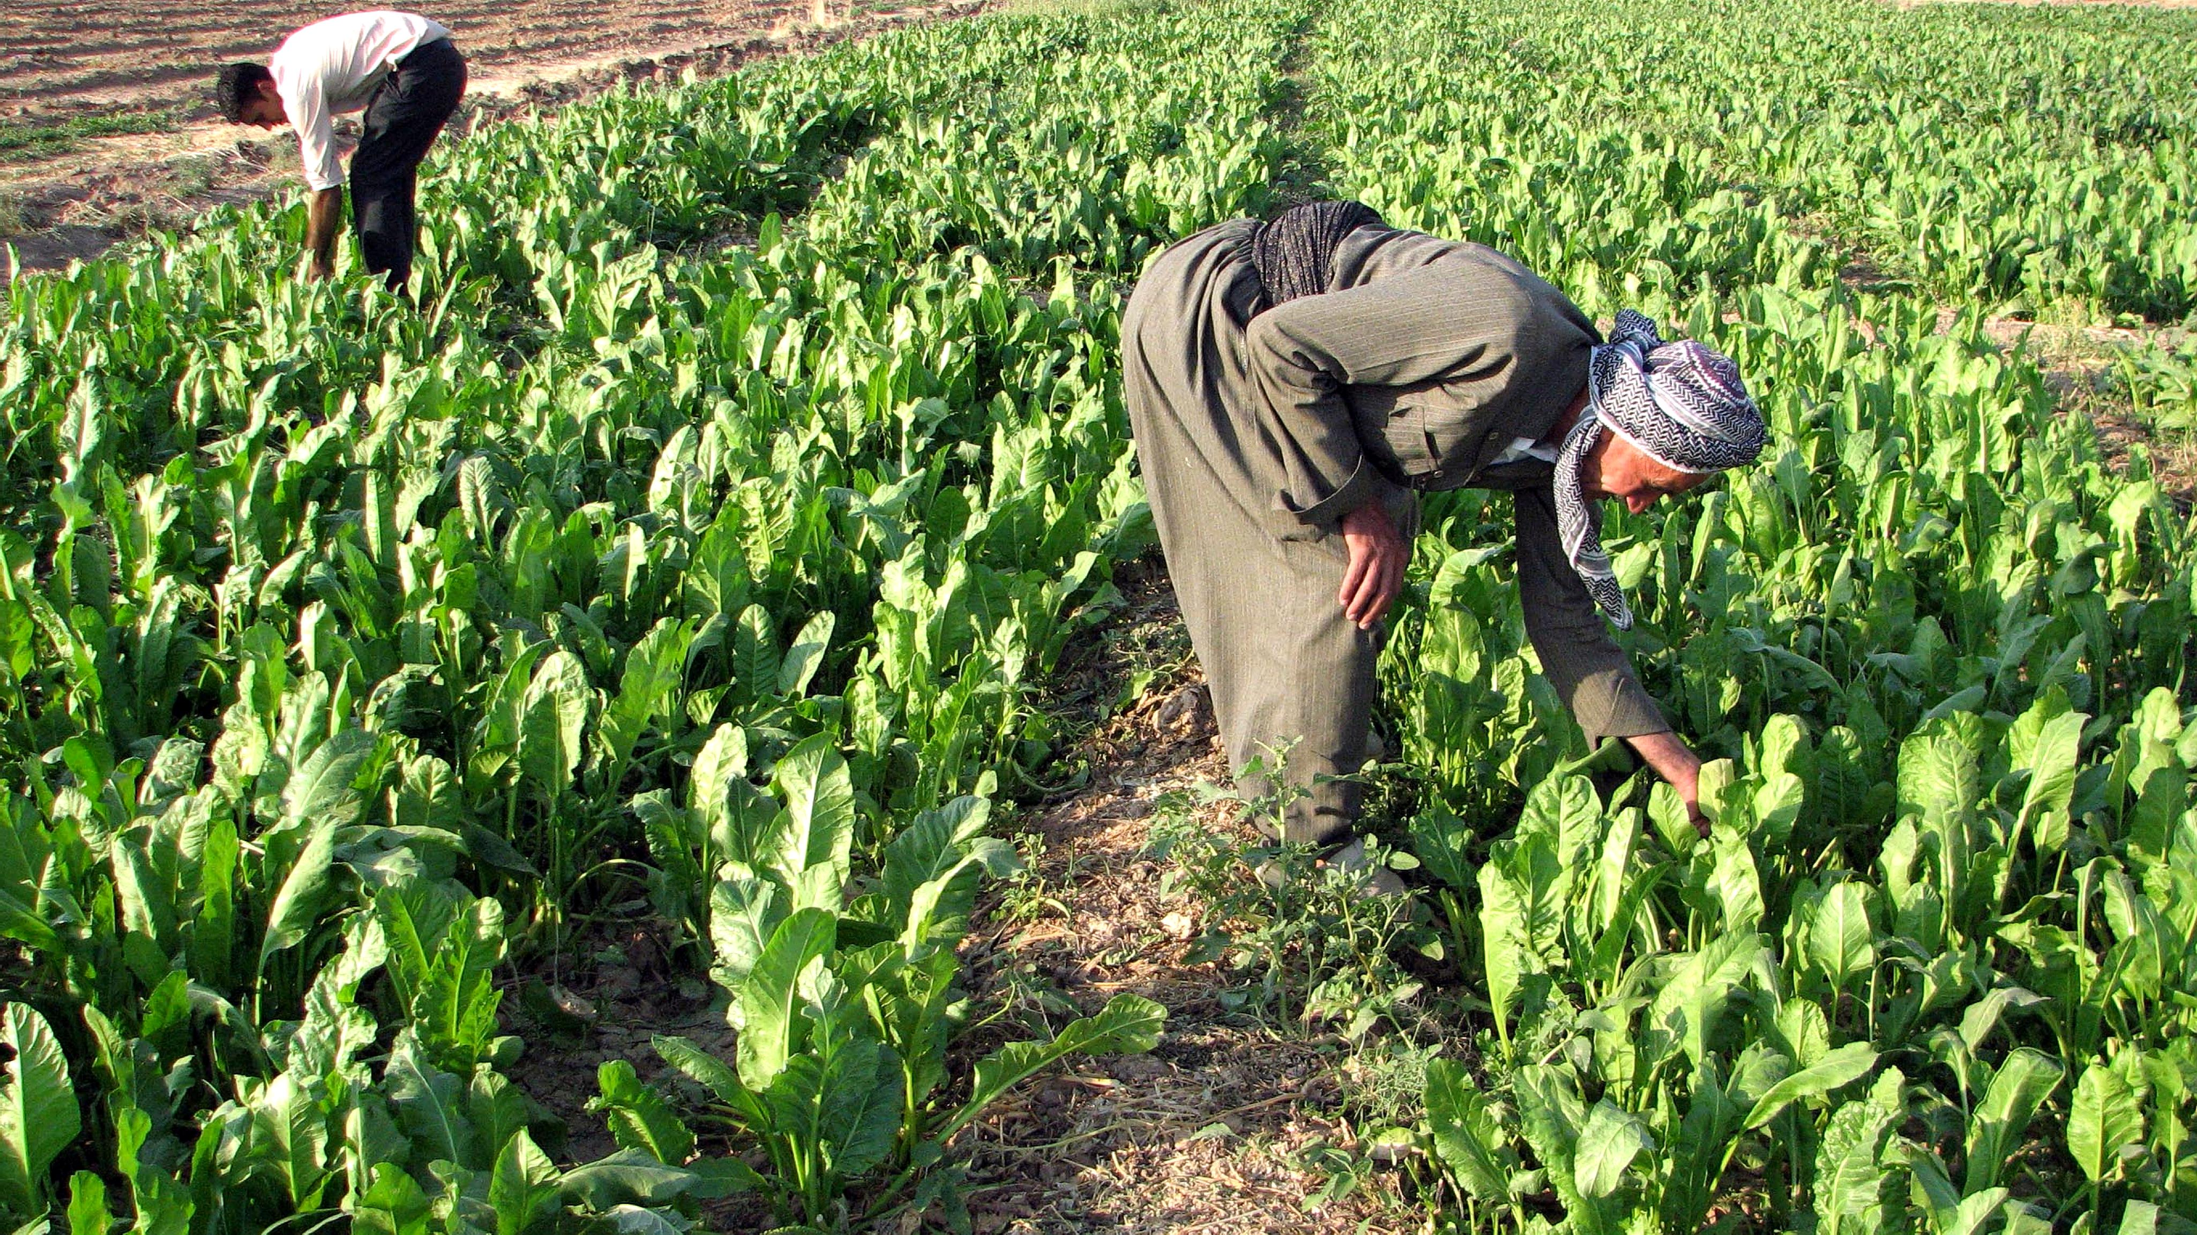
Upon scrutinizing Yemen's World Bank IDA data, notable trends surface regarding project types, borrowing entities, and loan statuses. Infrastructure development, healthcare initiatives, educational programs, and agricultural advancements represent key areas of investment. Borrowing entities include the Minister of Planning & International Cooperation, H.E. Dr. Mohammed Saed Al-Sadi, Ministry of Agriculture & Fisheries, and Tresorier Payeur General, each contributing to Yemen's developmental agenda. Loan statuses range from cancelled and disbursed to fully repaid and ongoing repayment, reflecting the dynamic financial landscape underpinning Yemen's development efforts. Hopefully, with continued support from programs like the World Bank IDA the Yemeni people can realize a reality where things like education, clean water and nutritious food become a staple instead of the country being destroyed by war.

Slide 10

Call to Action If you enjoyed my SQL analysis of World Bank IDA Data and would like to discuss it more, please feel free to connect with me on LinkedIn or send me an Email. I’d love to connect and hear your thoughts or tips on my analysis or how I could improve.
This Photo by Unknown Author is licensed under CC BY-NC-ND

